Slide 1
Matt 17:20
“If you have faith as a mustard seed, you shall say to this mountain, 'Move from here to there,' and it shall move; and nothing shall be impossible to you.”

Slide 3
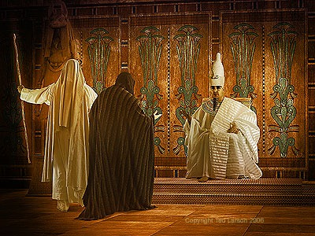
Working With God or Against?
Exodus 5-6

Slide 4
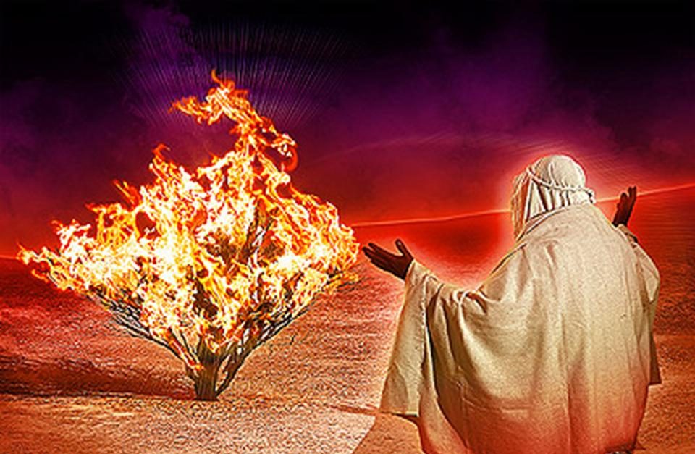
God Sends Moses Back… To Deliver Israel
God Has Heard Israel’s Cry for Deliverance.
Moses “Disqualifies” Himself, But Finally Goes With Aaron at His Side.
Moses Not Only Has to Talk to Pharaoh, but to Israel.

Slide 5
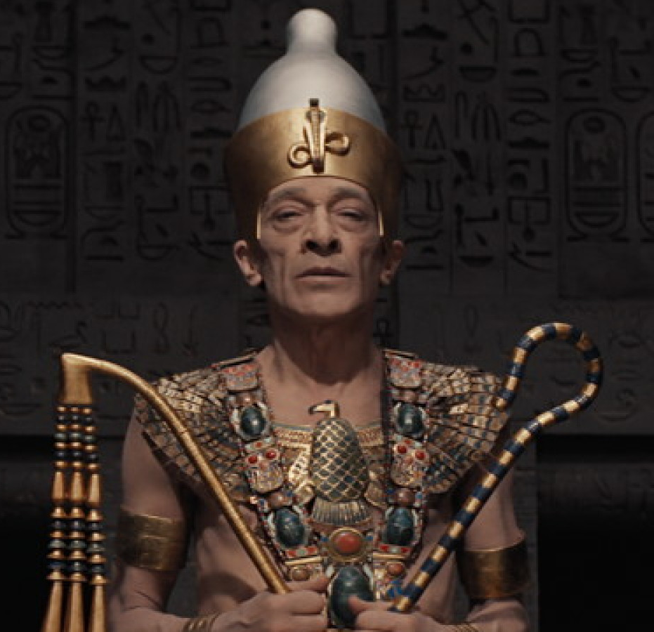
God’s Plan for Pharaoh
5:1-2 = “I Don’t Have to Obey Because I Don’t Know Him.”
WRONG!
5:3-9 = Make It Difficult for Them Because They Want to Obey God.
Notice Moses Is Clearly Seen as a Hebrew and Not an Egyptian (4).
6:1 = Pharaoh Will Obey, But It Won’t Count.

Slide 6
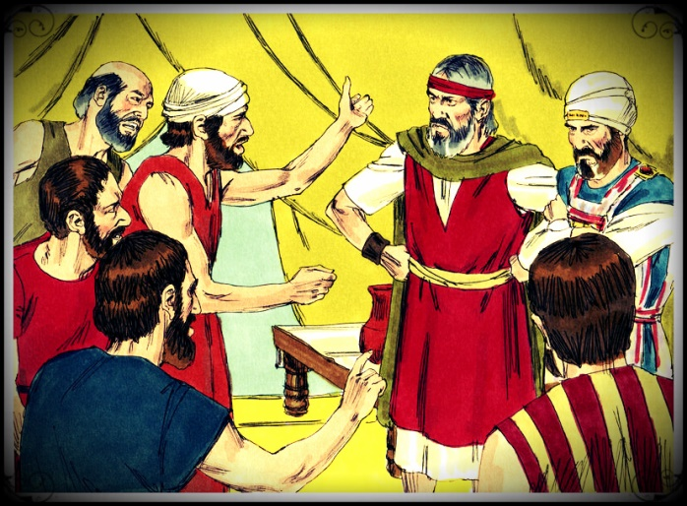
God’s Plan for Israel
5:14-19 = COMPLAIN
1st to Pharaoh
2nd to Moses (5:20-21)
Sometimes There Will be Challenges and Even Road Blocks.
Keep In Mind Satan Is At Work Also.
What Will You Do?

Slide 7
James 5:9
“Do not complain, brethren, against one another, that you yourselves may not be judged; behold, the Judge is standing right at the door.”

Slide 8
Job 33:13
Elihu Questions Job…
“Why do you complain against Him, That He does not give an account of all His doings?”

Slide 9
Complaining
Can Thwart God’s Plan (6:9).
Can Cause Others to Doubt God.
Can Show a Lack of Trust and Confidence in God.
Is Exactly What Satan Wants Us to Do.

Slide 10
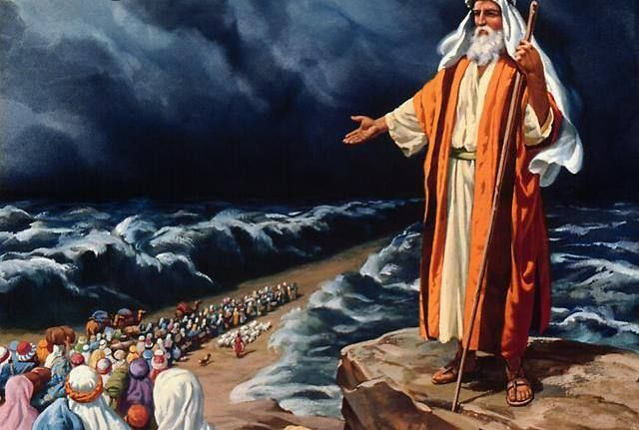
God’s Plan for Moses
5:3 = “God Will Fall on Us” ???
5:22-23 = Moses Complains.
6:12 = Tries to Disqualify Himself…Again.
6:13 = “God Gave Them a Charge”

Slide 11
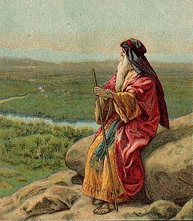
God’s Plan for You
Which of These Characters Will You Imitate?
We Must Trust God and …
Not Complain
Not Make Excuses
Not Obey Under Compulsion
Not Give Up

